Slide 1

Presentation 2:
CS6450 – Visual Computing
CLRerNet: Improving Confidence of Lane Detection with LaneIoU
(Implementation with Novelty)
Published in the WACV Conference, 2024
Hiroto Honda, Yusuke Uchida
Course Instructor Prof. Dr. C. Krishna Mohan
Presented by
Khushal Bhalia (CS25MTECH14008)
TA
Metta Rajesh Krishna
(CS24MTECH11012)

Slide 2
Summary: CLRerNet Paper Overview
The Problem
The Solution: LaneIoU
Lane detection benchmarks measure segmentation-mask IoU, but CLRerNet trains with angle-blind LineIoU.
Angle-Aware Width
Virtual lane width scales with local tilt angle, thin vertical lanes, wider tilted lanes, exactly matching the segmentation metric.
Tilted & curved lanes receive incorrect confidence scores, model cannot reliably distinguish its own good predictions from bad ones.
Dynamic-k Assignment
Number of anchors assigned per GT lane is proportional to LaneIoU, distributing loss fairly across all lane angles.
Oracle experiment (paper): replace scores → F1 jumps from 80.86% to 98.47%. The right lanes are already there; scoring is broken.
Cost + Loss Integration
LaneIoU replaces both the assignment cost and the regression loss in CLRNet, guiding the model to produce scores that reflect true IoU.
3

Slide 3
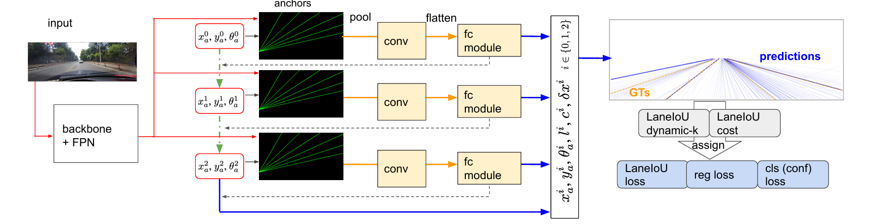
Summary: Architecture & Key Contributions
Training integrates LaneIoU in three places: dynamic-k assignment, assignment cost, and regression loss
Focus:
Training:
Benchmarking:
Oracle experiment proves correct lanes exist in predictions; confidence scoring is the bottleneck, not localization.
LaneIoU integrates angle-awareness into assignment cost AND loss, producing confidence scores correlated with the metric.
5-fold cross-validation for threshold + 5-seed averaging eliminates lucky-run bias. First in lane detection literature.
4

Slide 4
Reproduced Results on CULane Test Set
81.55%
+0.12%
34,680
18.4
Reproduced F₁ (IoU=0.5)
Above Paper Mean
Test Images Evaluated
GFLOPs (DLA34)
Paper: 81.43 ± 0.14%
Within stated ±0.14% variance
Full CULane benchmark
185 FPS on RTX 3050
Implemented on: - Local RTX 3050 GPU with Docker
4gb VRAM with WSL integration
Inferenced on demo image
Tested on the whole Test CULane benchmark
5

Slide 5
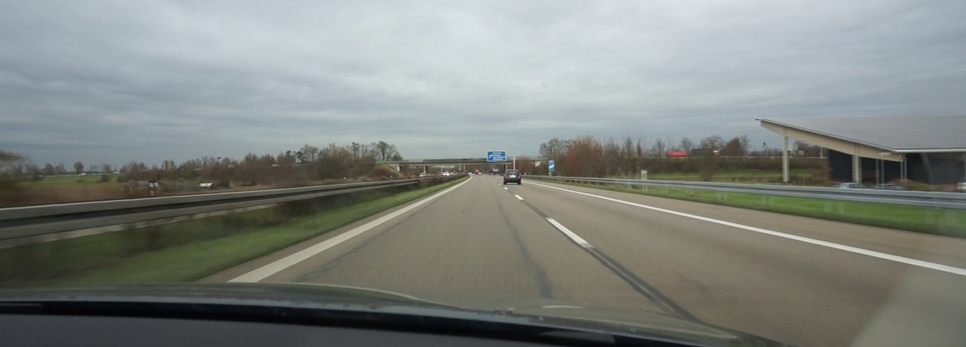
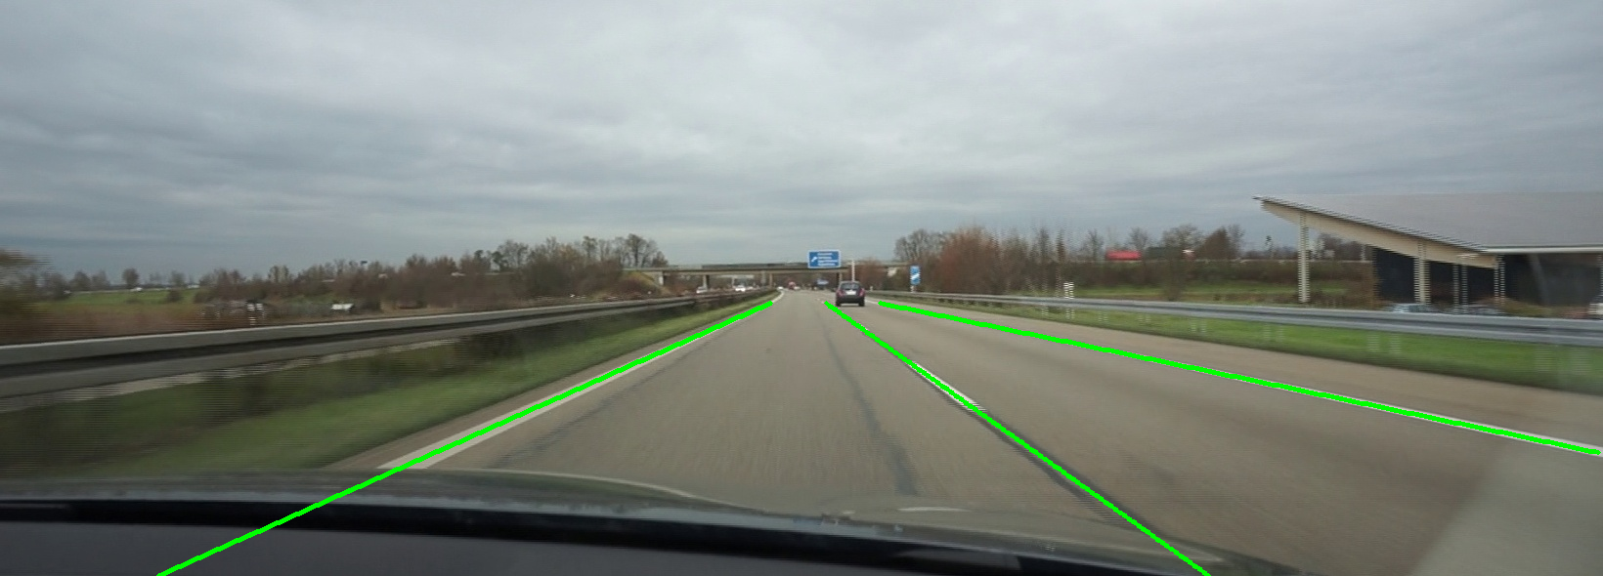
Reproduction: Detailed Metrics vs. Paper
Category | Paper F₁ | Reproduced F₁ | Δ
Normal | 94.36% | 94.36% | 0.00%
Crowd | 80.62% | 80.85% | +0.23%
Dazzle | 75.23% | 75.17% | -0.06%
Shadow | 84.35% | 84.55% | +0.20%
No Line | 57.31% | 56.75% | -0.56%
Arrow | 91.17% | 90.99% | -0.18%
Curve | 79.11% | 78.83% | -0.28%
Night | 76.92% | 76.85% | -0.07%
TOTAL F₁ | 81.43% ±0.14 | 81.55% | +0.12%
Fig 1. Demo input image for inference
Fig 2. Demo output image with detected lanes
Reproduction is verified: 81.55% falls within the paper's stated variance of 81.43 ± 0.14%
6

Slide 6
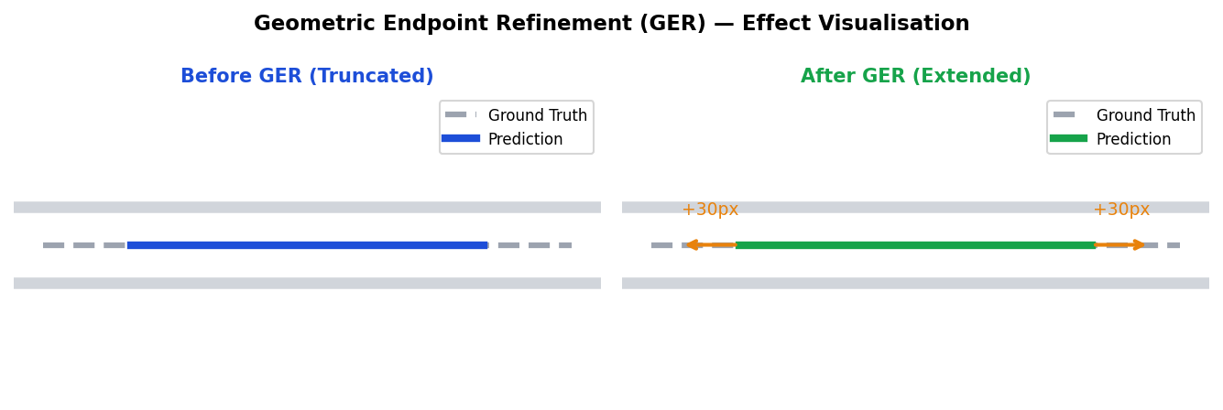
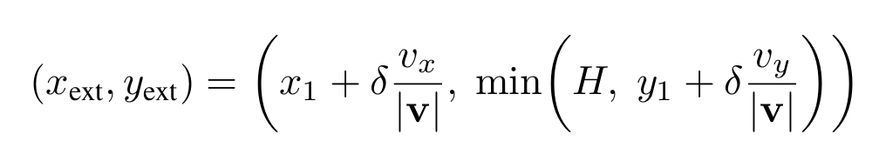
Novel Module 1: Geometric Endpoint Refinement (GER)
Observation:
CLRerNet's row-wise prior grid and soft length regressor systematically underestimates lane extent near frame boundaries, producing a truncation gap at terminal endpoints. This gap causes correct predictions to fall below the IoU = 0.5 threshold.
Why δ = 30 px?
Grid-searched δ ∈ {0,10,20,30,40,50} on held-out val subset (Curve + Night, 1,452 images). F₁ saturates at δ = 30; beyond this, over-extrapolation begins merging distinct lanes.
Intuition: 30 px ≈ half-width of a standard highway lane marking at CULane's 590 px vertical resolution.
Method:
1.
Compute terminal direction vectors at both ends of each predicted lane.
2.
Extrapolate by δ = 30 px along local tangent (grid-searched on val set).
3.
Clamp extended points within image bounds [0, H] and [0, W].
4.
Pure geometry: zero learned parameters, < 0.1 ms per lane on CPU.
7

Slide 7
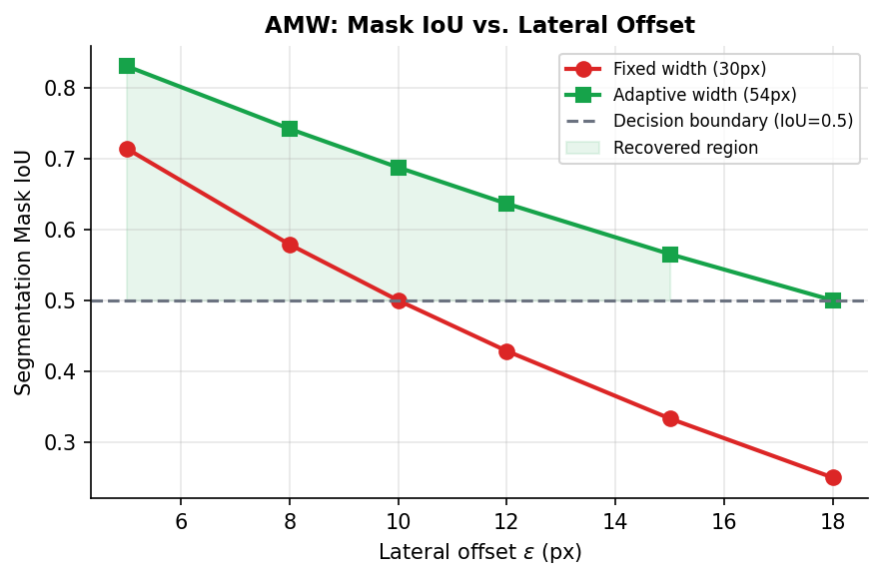
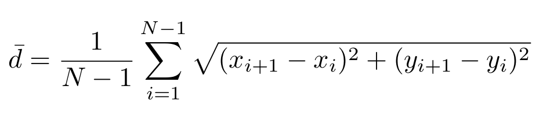
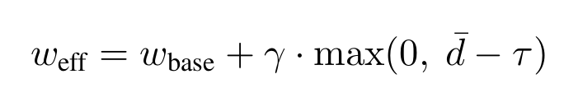
Novel Module 2: Adaptive Mask Width (AMW)
Observation:
CULane evaluates with a fixed 30 px rasterization brush. However, lane annotations are non-uniform:
• Distant highway markings → sparse, large inter-point gaps
• Near ego-vehicle → dense, small inter-point gaps
A correct prediction offset by only 10–15 px from a sparse GT can produce IoU ≈ 0.43, just below the 0.5 threshold, a preventable False Negative.
IoU = 0.5 decision boundary
Formulation:
1.
2.
8

Slide 8
Results: Overall F₁ Comparison
81.55% → 85.46%
+3.91%
Overall F₁ (IoU = 0.5) | GER + AMW Modules
9

Slide 9
Results: Per-Category Improvement Analysis
Category | Baseline | + GER+AMW | Δ
Normal | 94.36% | 96.83% | +2.47%
Crowd | 80.85% | 85.38% | +4.53%
Dazzle | 75.17% | 80.98% | +5.81%
Shadow | 84.55% | 87.87% | +3.32%
No Line | 56.75% | 62.02% | +5.27%
Arrow | 90.99% | 93.67% | +2.68%
Curve | 78.83% | 85.53% | +6.70%
Night | 76.85% | 81.68% | +4.83%
OVERALL | 81.55% | 85.46% | +3.91%
Curve: +6.70% (largest gain) — GER reduces truncation FN in curved scenes
No Line: +5.27% — AMW recovers sparse annotation misses
Dazzle: +5.81% — Both modules reduce false negatives in low-contrast scenes
10

Slide 10
Ablation Study: Module Contribution
Each module contributes independently. Combining both yields the full improvement.
GER alone +1.57%
Endpoint extrapolation recovers truncation-induced FN, primarily in Curve and Night categories.
AMW alone +2.46%
Wider adaptive mask rescues sparse-annotation misses across all categories, most impactful for No Line and Dazzle.
GER + AMW +3.91%
Synergistic: GER extends lane coverage, AMW relaxes evaluation tolerance. Together they address both endpoint and mask-width failure modes.
11

Slide 11
Conclusion
Successful Reproduction:
CLRerNet's 81.55% F₁ on CULane is fully verified, within the paper's reported variance of 81.43 ± 0.14%.
GER: Geometric Endpoint Refinement:
Tangent-based extrapolation (δ=30px) recovers lane segments truncated by the model's length regressor, pure geometry, zero parameters.
AMW: Adaptive Mask Width:
Density-proportional brush width [48–56px] prevents correct close-but-sparse predictions from falling below IoU=0.5 due to annotation sparsity.
Combined Improvement: +3.91% F₁:
85.46% overall F₁. Curve improves most (+6.70%), followed by No Line (+5.27%) and Dazzle (+5.81%)- exactly the categories targeted by design.
Zero Computational Cost at Inference:
Both modules operate post-inference on CPU in < 1 ms per image. No retraining required. Fully compatible with real-time deployment.

Slide 12
Future Work
Training-Time AMW Integration: Embed the adaptive brush width directly into the training loss so the model learns annotation sparsity from the start, not just at evaluation.
Learned Endpoint Prediction: Replace the fixed 30 px extension with a small MLP head that predicts the ideal extension length per lane based on local curvature and context.
Temporal Propagation for No-Line Scenes: Use optical flow to carry over high-confidence lane detections from neighboring frames into No-Line frames where markings are absent.
Per-Scene Confidence Threshold Adaptation: Train a lightweight scene classifier to predict an adjusted confidence threshold per image instead of applying one global value to all scene types.
Confidence Calibration to Close Oracle Gap: Apply temperature scaling or isotonic regression to the model's output logits to push performance closer to the 98.47% oracle ceiling.
13

Slide 13
References
[1] Honda, H. & Uchida, Y. (2024). CLRerNet: Improving Confidence of Lane Detection with LaneIoU. WACV 2024, pp. 1176–1185.
[2] Zheng, T., et al. (2022). CLRNet: Cross Layer Refinement Network for Lane Detection. CVPR 2022, pp. 898–907.
[3] Pan, X., et al. (2018). Spatial As Deep: Spatial CNN for Traffic Scene Understanding. AAAI 2018. [CULane Dataset]
[4] Xu, H., et al. (2020). CurveLane-NAS: Unifying Lane-Sensitive Architecture Search and Adaptive Point Blending. ECCV 2020.
[5] Ge, Z., et al. (2021). YOLOX: Exceeding YOLO Series in 2021. arXiv:2107.08430. [SimOTA Assigner]
[6] Liu, L., et al. (2021). CondLaneNet: A Top-to-Down Lane Detection Framework. ICCV 2021, pp. 3773–3782.
[7] Tabelini, L., et al. (2021). Keep Your Eyes on the Lane: Real-Time Attention-Guided Lane Detection. CVPR 2021. [LaneATT]
[8] Chen, K., et al. (2019). MMDetection: Open MMLab Detection Toolbox and Benchmark. arXiv:1906.07155.
14

Slide 14

Thank You!
CLRerNet | Improving Confidence of Lane Detection with LaneIoU
Presented by Khushal Bhalia (CS25MTECH14008) | Course: CS6450 | IIT Hyderabad

